Slide 1

3 forms of programming
By: Daan G, Jens and Nathan

Slide 2
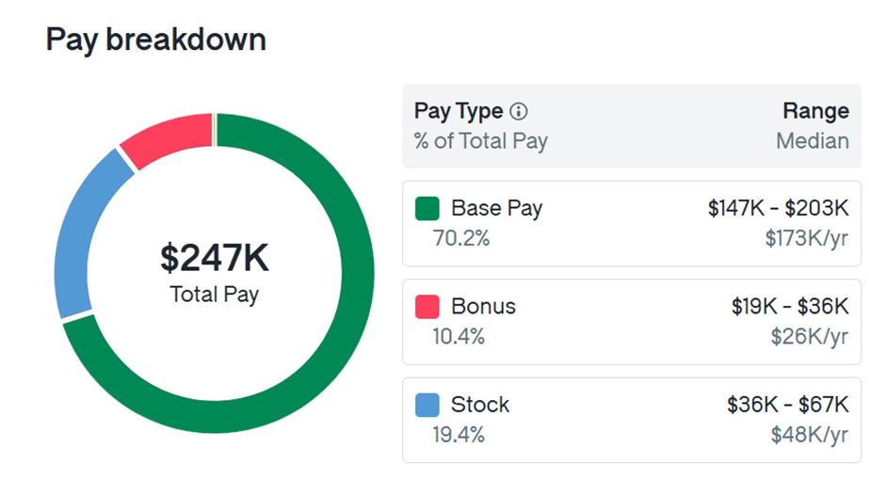
similarities
Working in and as a team.
Debugging your code
Job application time
Logic of the code
Differences
Coding languages differ
Coding workplaces
Payrate

Slide 3

Game Development:

Slide 4
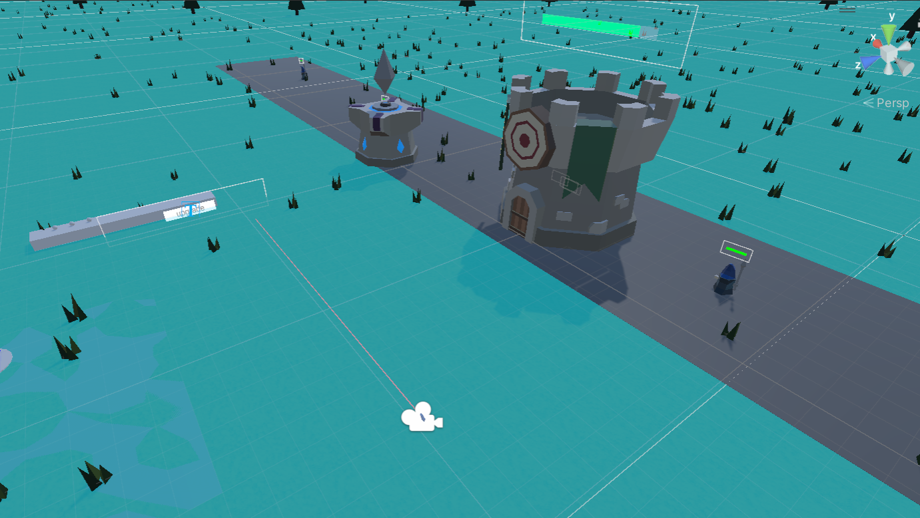
AR/XR development:

Slide 5

Web Development:

Slide 6

Our specialities

